Slide 1
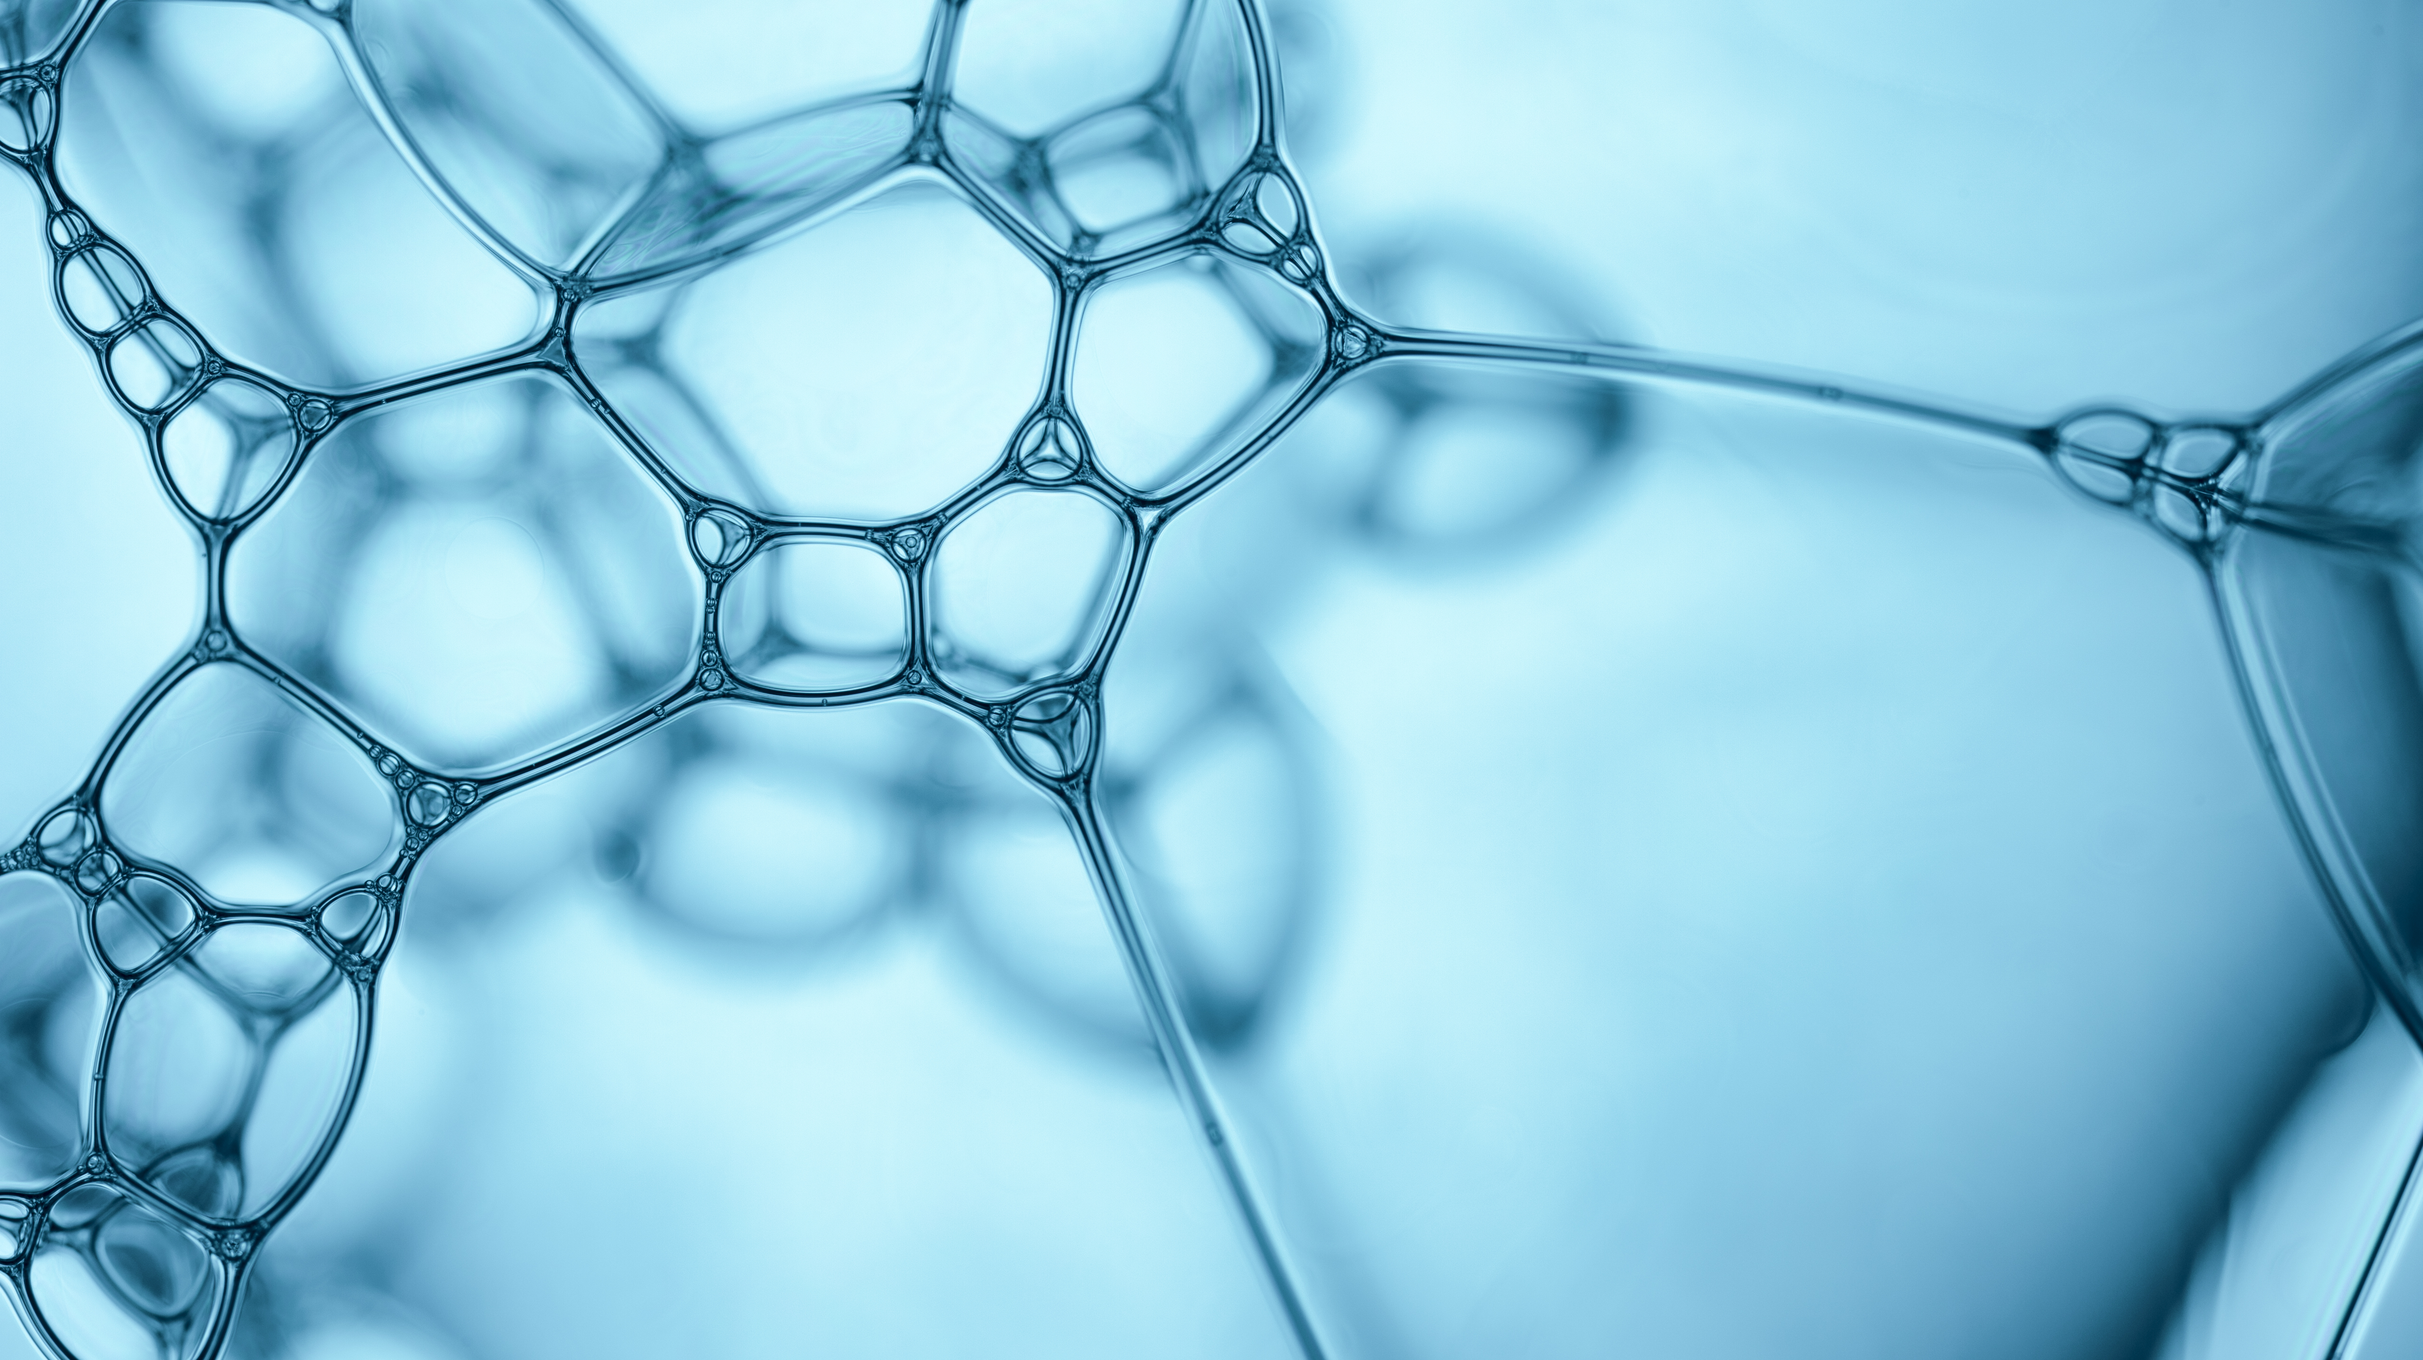
Comparative Study of Machine Learning Algorithms for Cancer Detection Using Mammographic Masses
Prepared by:
Mahnoor Athar
Laiba Mazhar
Shanza Bakht
Presented to:
Dr. Amanullah Yasin

Slide 2
Agenda
Introduction
Literature Review
Problem Statement
Dataset
Attributes Information
Proposed Methodologies
Results
Conclusion

Slide 3
Introduction
After skin cancer, breast cancer is the most common cancer diagnosed in women in the United States. Breast cancer can occur in both men and women, but it's far more common in women.
Substantial support for breast cancer awareness and research funding has helped create advances in the diagnosis and treatment of breast cancer.
Breast cancer survival rates have increased, and the number of deaths associated with this disease is steadily declining, largely due to factors such as earlier detection, a new personalized approach to treatment and a better understanding of the disease[1].

Slide 4
Literature Review
Title | Proposed Methodologies | Main Contribution/ Limitation
Applying Best Machine Learning Algorithms for Breast Cancer Prediction and Classification [2] | Uses the WBCD dataset and implements Random Forest, Naïve Bayes, SVM and KNN algorithms | No mention of non-linearities and pre-processing of data
A Comparative Analysis of Nonlinear Machine Learning Algorithms for Breast Cancer Detection [3] | Uses the WBCD dataset and implements Multilayer Perceptron, KNN, Classification and Regression Trees (CART), Gaussian Naïve Bayes and SVM algorithms | Concludes that Multilayer Perceptron is the best
Prediction of Malignant & Benign Breast Cancer: A Data Mining Approach in Healthcare Applications[4] | Ada Boost M 1, Decision Table, J Rip, Lazy IBK, Logistics Regression, Multiclass Classifier, Multilayer Perceptron, Naive Bayes, Random forest and Random Tree are analyzed on WBCD | This work focuses on different classification techniques implementation for data mining in predicting malignant and benign breast cancer

Slide 5
Contd.
Title | Proposed Methodologies | Main Contributions/ Limitations
A Hybrid Approach for Breast Cancer Classification and Diagnosis[5] | Uses SVM and ANN on the WBCD | Data Analytics and machine learning methods provides framework for prognostic studies by errorless classification of data instances into relevant class based on the cancer severity
Dataset of breast mammography images with masses[6] | Uses 106 breast mammography images with masses from INbreast database. And using data augmentation, images were increased to 7632 and then apply the CNN models including AlexNet, DenseNet, and ShuffleNet. | Utilize data augmentation and classify these mammography images

Slide 6
Problem Statement
To compare and analyze different machine learning techniques (Supervised Learning and Ensemble) for efficient detection of Breast Cancer through Mammographic Masses.

Slide 7
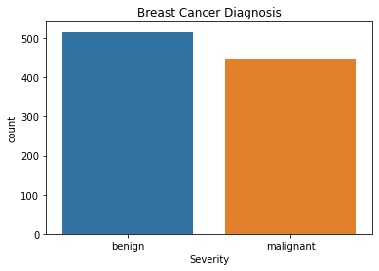
Dataset
The dataset being used is Mammographic Mass Data Set from UCI Machine Learning Repository.[7]
Mammography is the most effective method for breast cancer screening available today.
This dataset can be used to predict the severity (benign or malignant) of a mammographic mass lesion from BI-RADS attributes and the patient’s age.
This dataset has 961 instances and 6 attributes, and the class distribution is benign: 516 and malignant: 445.

Slide 8
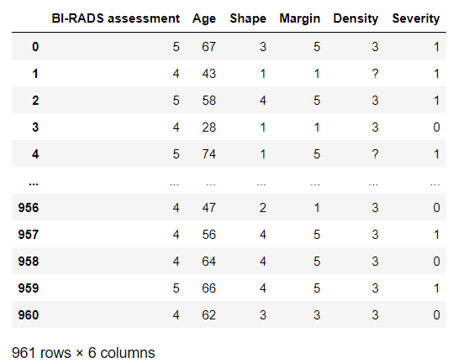
Contd.

Slide 9
Attribute Information
6 Attributes in total (1 goal field, 1 non-predictive, 4 predictive attributes):
BI-RADS assessment: 1 to 5 (ordinal)
Age: patient's age in years (integer)
Shape: mass shape: round=1, oval=2, lobular=3, irregular=4, (nominal)
Margin: mass margin: circumscribed=1, microlobulated=2, obscured=3, ill-defined=4, spiculated=5 (nominal)
Density: mass density high=1, iso=2, low=3, fat-containing=4 (ordinal)
Severity: benign=0 or malignant=1 (binominal, goal field!)
Missing Attribute Values:
BI-RADS assessment: 2
Age: 5
Shape: 31
Margin: 48
Density: 76
Severity: 0

Slide 10
Proposed Methodologies
We have used the Mammographic Mass Data Set from UCI Machine Learning Repository and applied K-Nearest Neighbors (KNN), Random Forest, Logistic Regression, Support Vector Machines (SVM), Naïve Bayes and Adaptive Boosting (AdaBoost) models to it.

Slide 11
Loading Dataset
Pre-processing
Model Building
Evaluating Results
Result
Data Cleaning
UCI Repository
Classification
Training
Best Classifier
Attribute Selection
Results Evaluation
Data Acquisition
Testing
Set Target Class
SVM
Random Forests Logistic Regression Decision tree
KNN
Naïve Bayes, and AdaBoost
Feature Extraction

Slide 12
Results
Results using drop.nan
Results using Statistical Methods
Model | Accuracy
KNN | 74%
Random Forest | 79%
Logistic Regression | 76%
SVM | 81%
Naïve Bayes | 79%
AdaBoost | 84%
Decision Tree | 78%
Model | Accuracy
KNN | 81%
Random Forest | 81%
Logistic Regression | 84%
SVM | 84%
Naïve Bayes | 83%
AdaBoost | 82%
Decision Tree | 83%

Slide 13
Contd.
Validation of Results Using F1 Score
Model | F1 Score
KNN | 0.782609
Random Forest | 0.789474
Logistic Regression | 0.836364
SVM | 0.835165
Naïve Bayes | 0.813433
AdaBoost | 0.803089
Decision Tree | 0.811024

Slide 14
Conclusion
These results are only for Mammographic Masses dataset and show that the data itself was not sourced reliably.
The performance only reflects the Mammographic Masses dataset and can be described as a limitation of our work.
In future, these algorithms should be applied to other datasets to verify or disprove these results.

Slide 15
Thank You for Listening!

Slide 16
References
[1] Breast cancer - Symptoms and causes. (2022, April 27). Mayo Clinic. https://www.mayoclinic.org/diseases-conditions/breast-cancer/symptoms-causes/syc-20352470
[2] Applying Best Machine Learning Algorithms for Breast Cancer Prediction and Classification. (2018, December 1). IEEE Conference Publication | IEEE Xplore. https://ieeexplore.ieee.org/abstract/document/8610632
[3] University of Toledo. (2019, June). A Comparative Analysis of Nonlinear Machine Learning Algorithms for Breast Cancer Detection - Volume 9 Number 3 (Jun. 2019) - IJMLC. http://www.ijmlc.org/index.php?m=content&c=index&a=show&catid=85&id=921
[4] Kumar, V. (2019, February 11). Prediction of Malignant & Benign Breast Cancer: A Data Mining. . . arXiv.org. https://arxiv.org/abs/1902.03825

Slide 17
Contd.
[5] Sahu, B., Mohanty, S., & Rout, S. (2018). A Hybrid Approach for Breast Cancer Classification and Diagnosis. ICST Transactions on Scalable Information Systems, 0(0), 156086. https://doi.org/10.4108/eai.19-12-2018.156086
[6] Huang & Lin, Department of Industrial Engineering & Management, National Chin-Yi University of Technology, Taichung, Taiwan (2020, July 2). Dataset of breast mammography images with masses. ScienceDirect. https://www.sciencedirect.com/science/article/pii/S2352340920308222?via=ihub
[7] UCI Machine Learning Repository: Mammographic Mass Data Set. (n.d.). Retrieved October 31, 2022, from https://archive.ics.uci.edu/ml/datasets/Mammographic+Mass
[8] Naji, M. A., Filali, S. E., Aarika, K., Benlahmar, E. L. H., Abdelouhahid, R. A., & Debauche, O. (2021, September 8). Machine learning algorithms for breast cancer prediction and diagnosis. Procedia Computer Science. Retrieved October 31, 2022, from https://www.sciencedirect.com/science/article/pii/S1877050921014629

